Slide 1
Python Basics
June 30th, 2019
本週進度:
從零開始學Python (Chapter 4.2/4.3)
Python 3.x程式語言特訓教材 (Chapter 8)

Slide 2
String (字串)
Create an empty string
Str_1 = str()
Str_2 = “” 或 ‘’
String initialization
Str = “I love Python.”
Indexing & Slicing
Str[0]
Str[4]
Str[0:4]
Str[::2]
Str[::-1]

Slide 3
+ / * operators
first_name = "Emily"
last_name = "Liao"
print(first_name + " " + last_name)
﻿print("=" * 20)

Slide 4
String is iterable
﻿for c in "Python":
print(c)

Slide 5
LeetCode 387. First Unique Character in a String
https://leetcode.com/problems/first-unique-character-in-a-string/
Given a string, find the first non-repeating character in it and return it's index. If it doesn't exist, return -1.
Examples:
s = "leetcode" return 0.
s = "loveleetcode", return 2.
s = "loveleetcode"
for idx, c in enumerate(s):
check = s[:idx] + s[idx+1:]
if c not in check:
print(idx)
break

Slide 6
Check a string
Str.isalpha()
Str.isdigit()
Str.isalnum()
Str.islower()
Str.isupper()
Str.isspace()

Slide 7
Sub-string
Str1.startswith(Str2)
Str1.endswith(Str2)
Str1.find(Str2)
Str1.rfind(Str2)
Str1.count(Str2)

Slide 8
Convert a string
Str.capitalize()
Str.lower()
Str.upper()
Str.title()
Str.swapcase()
Str.replace(old, new)

Slide 9
LeetCode 520. Detect Capital
Given a word, you need to judge whether the usage of capitals in it is right or not.
We define the usage of capitals in a word to be right when one of the following cases holds:
All letters in this word are capitals, like "USA".
All letters in this word are not capitals, like "leetcode".
Only the first letter in this word is capital, like "Google".
Otherwise, we define that this word doesn't use capitals in a right way.
Example 1:
Input: "USA”
Output: True
Example 2:
Input: "FlaG”
Output: False
word == word.upper()
word == word.lower()
word == word.title()

Slide 10
chr(int) / ord(char) LeetCode 709. To Lower Case
https://leetcode.com/problems/to-lower-case/
ASCII code
return str.lower()
res = ''
for c in str:
if 'A'<= c <= 'Z':
res += chr(ord(c) - ord('A') + ord('a'))
else:
res += c
return res

Slide 11
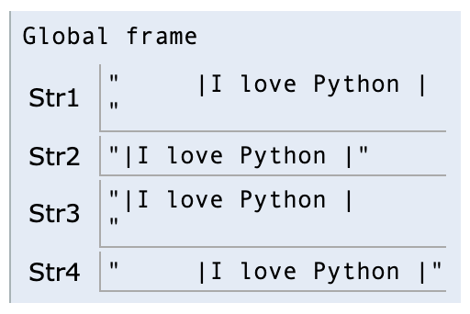
Str.strip()
Str1 = " \t|I love Python |\n\r”
Str2 = Str1.strip()
Str3 = Str1.lstrip()
Str4 = Str1.rstrip()

Slide 12
List[str] = str.split()
Str = "I love Python."
words = Str.split()
print(words)
Str = "I=*=love=*=Python."
words = Str.split("=*=")
print(words)

Slide 13
str.join(List[str])
words = ['I', 'love', 'Python.']
print(' '.join(words))
print('=*='.join(words))

Slide 14
LeetCode 824. Goat Latin
https://leetcode.com/problems/goat-latin/
Example 1:
Input: "I speak Goat Latin"
Output: "Imaa peaksmaaa oatGmaaaa atinLmaaaaa"
S = S.split()
for i in range(len(S)):
if S[i][0].lower() in ['a', 'e', 'i', 'o', 'u’]:
S[i] = S[i] + 'ma' + 'a'*(i+1)
else:
S[i] = S[i][1:] + S[i][0] + 'ma' + 'a'*(i+1)
return ' '.join(S)

Slide 15
Format a string (f-string)
﻿num = 123.456
print(f"(1) {num}")
print(f"(2) {num:10.2f}")
print(f"(3) {num:<10.2f}")
print(f"(4) {int(num)}")
print(f"(5) {int(num):10b}")

Slide 16
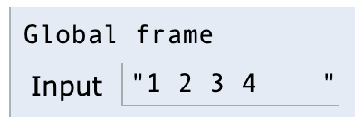
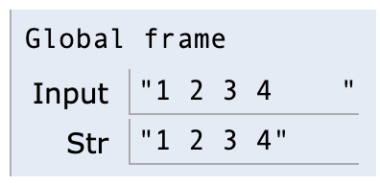
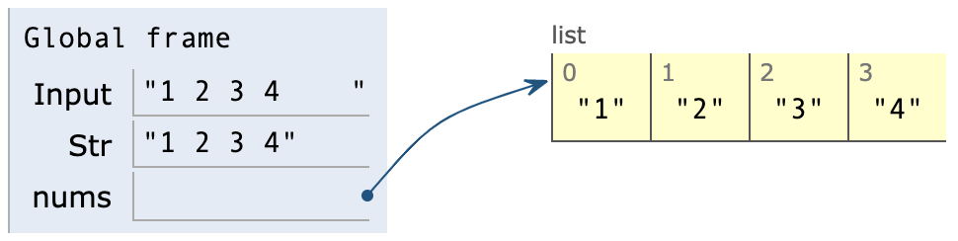
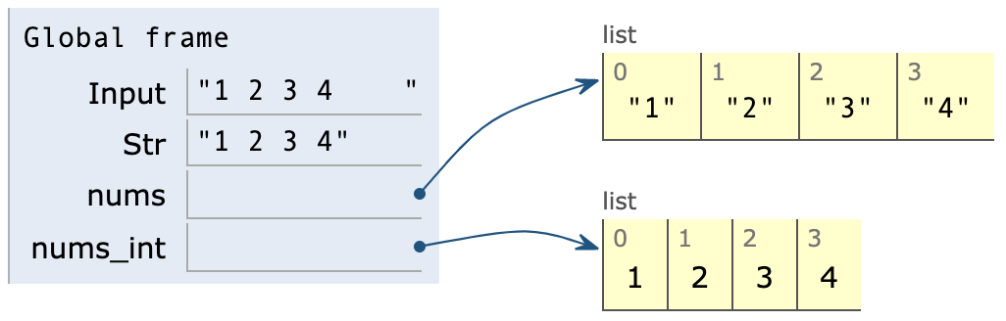
處理on-line judge的輸入測資 (空白分隔)
nums_int = list(map(int, input().strip().split()))
# === 說明 ===
Input = input()
Str = Input.strip()
nums = Str.split()
nums_int = list(map(int, nums))
(1)
(2)
(3)
(4)

Slide 17
LeetCode Challenges

Slide 18
List
# 202. Happy Number
num = 34
memory = [num]
while num != 1:
check = 0
for n in str(num):
check += int(n) ** 2
if check == 1:
print('True')
break
elif check in memory:
print('False')
break
else:
num = check
memory.append(check)
202. Happy Number
728. Self Dividing Numbers
941. Valid Mountain Array
1046. Last Stone Weight

Slide 19
String
344. Reverse String
383. Ransom Note
771. Jewels and Stones
804. Unique Morse Code Words

Slide 20
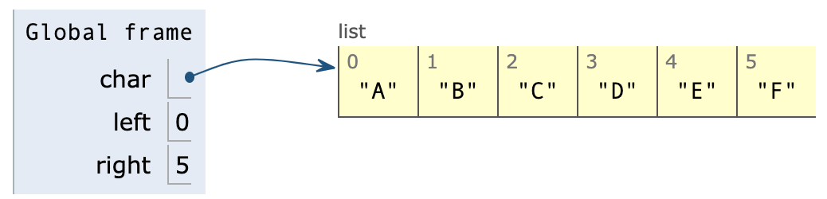
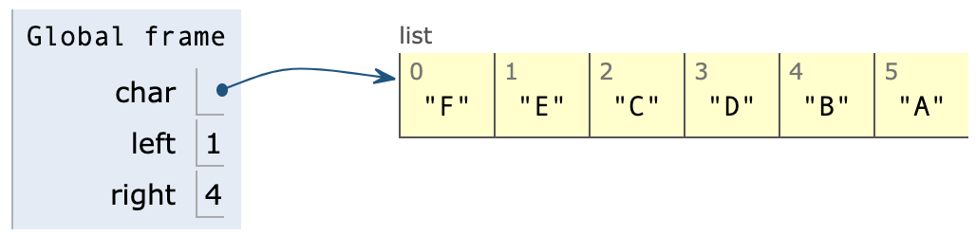

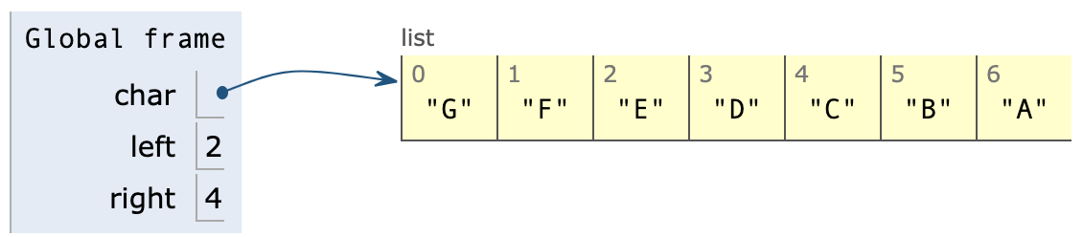
char = ['A', 'B', 'C', 'D', 'E', 'F']
left = 0
right = len(char) - 1
while left < right:
char[left], char[right] = char[right], char[left]
left += 1
right -= 1

